Slide 1
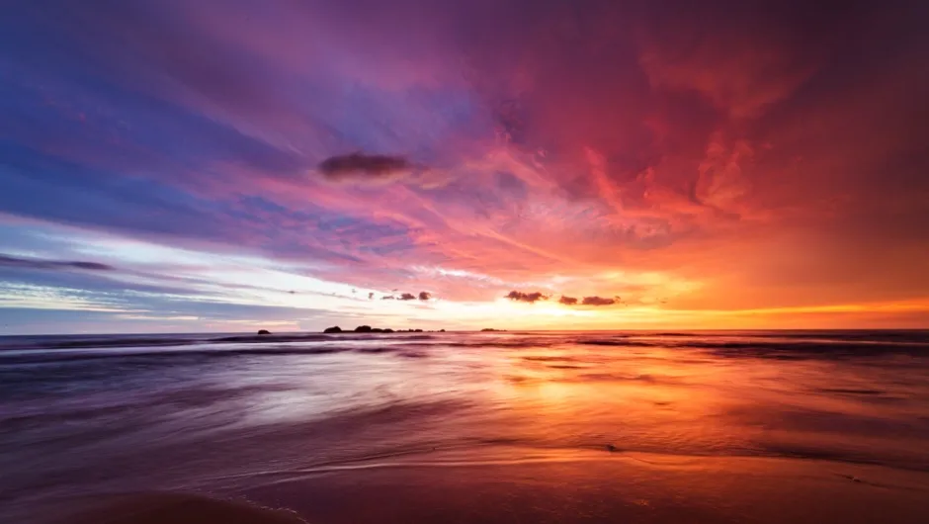
ITA0515-
COMPUTER VISION FOR SIGN LANGUAGE RECOGNITION
-PANDETI SAI VINITHA
(192125090)

Slide 2
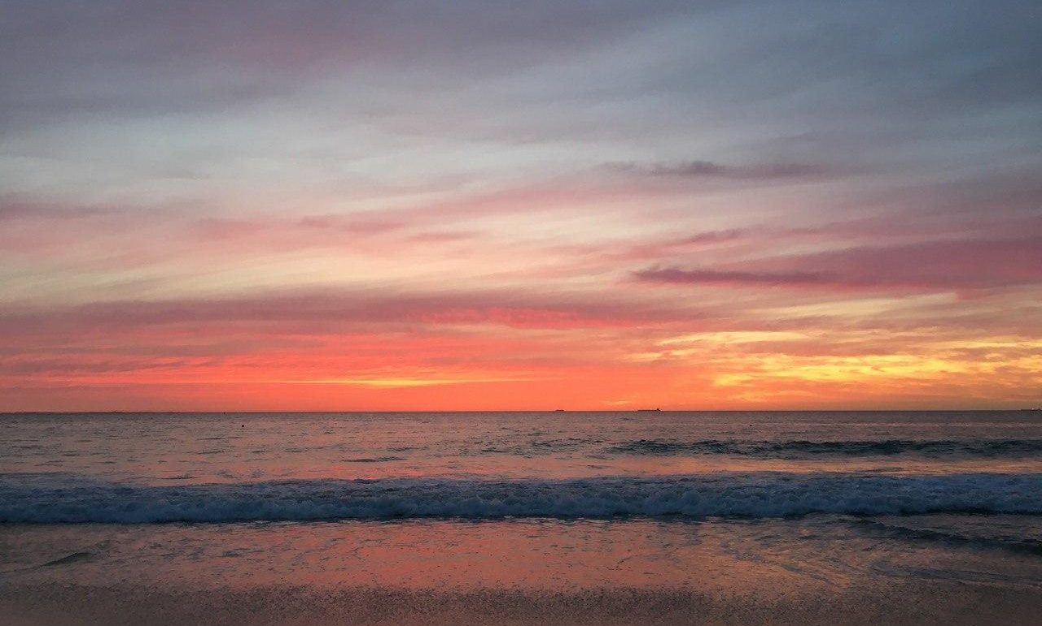
REAL-TIME SIGN LANGUAGE RECOGNITION
USING MEDIA PIPE AND
LSTM NEURAL NETWORKS

Slide 3
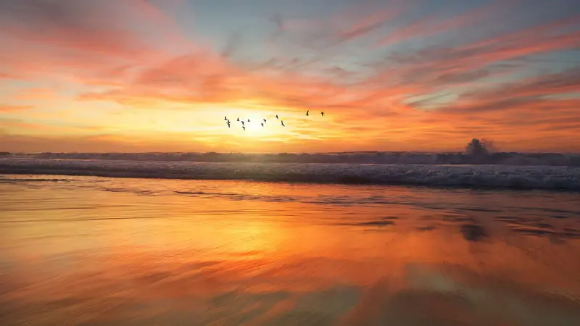
INTRODUCTION
Bringing Sign Language Recognition to Mobile Devices.
Facilitating Communication
Independence and Empowerment
Inclusive Technology
Breaking Communication Barriers
Improving Accessibility

Slide 4
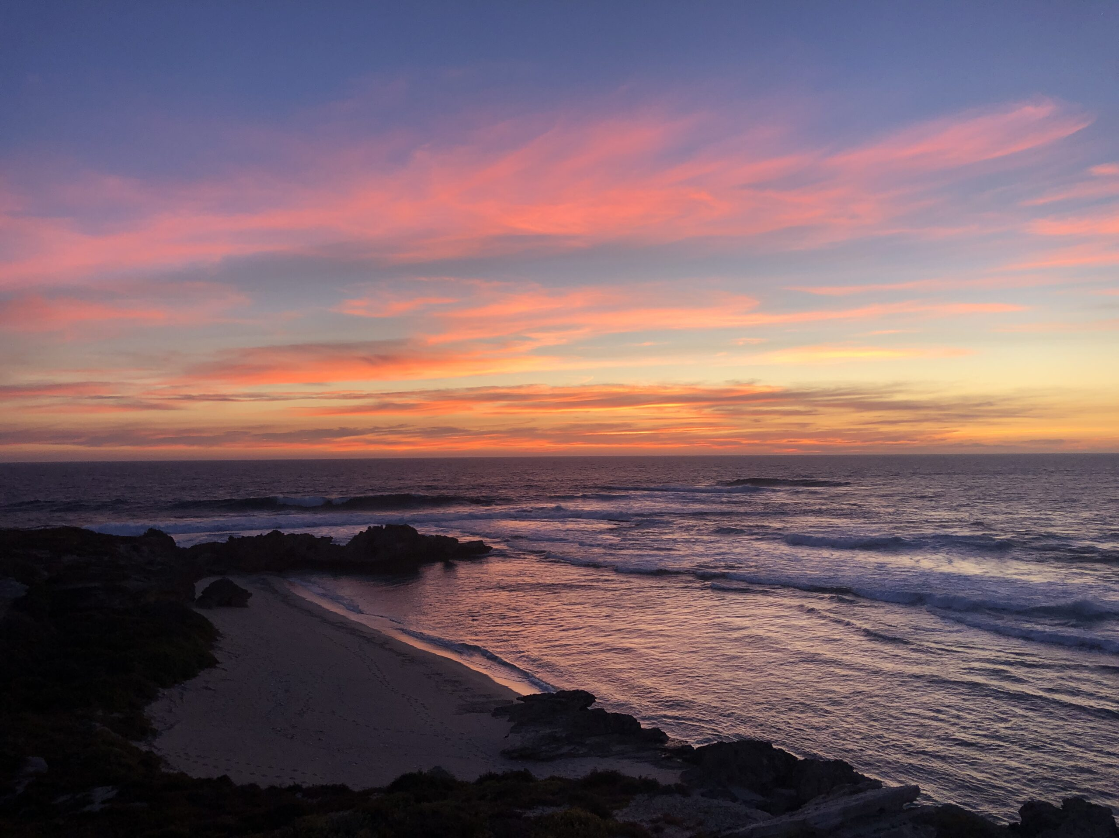
TECHNOLOGY STACK
Opencv For Computer Vision
Machine Learning Models
Mobile App Development Frameworks

Slide 5

SIGN LANGUAGE DETECTION PIPELINE
Implementing camera access within the app to capture live video.
Processing video frames in real-time using OpenCV libraries.

Slide 6
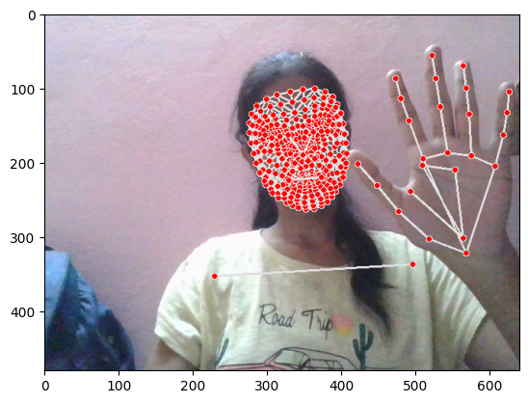
ap=cv2.VideoCapture(0)
#set mediapipe model
with mp_holistic.Holistic(min_detection_confidence=0.5,min_tracking_confidence=0.5)as holistic:
while cap.isOpened():
#read feed
ret,frame=cap.read()
#make detections
image,results= mediapipe_detection(frame, holistic)
print(results)
#draw landmarks
draw_styled_landmarks(image,results)
#show to screen
cv2.imshow('OpenCV Feed',image)
#break gracefully
if cv2.waitKey(10)& 0xFF == ord('a'):
break
cap.release()
cv2.destroyAllWindows()

Slide 7
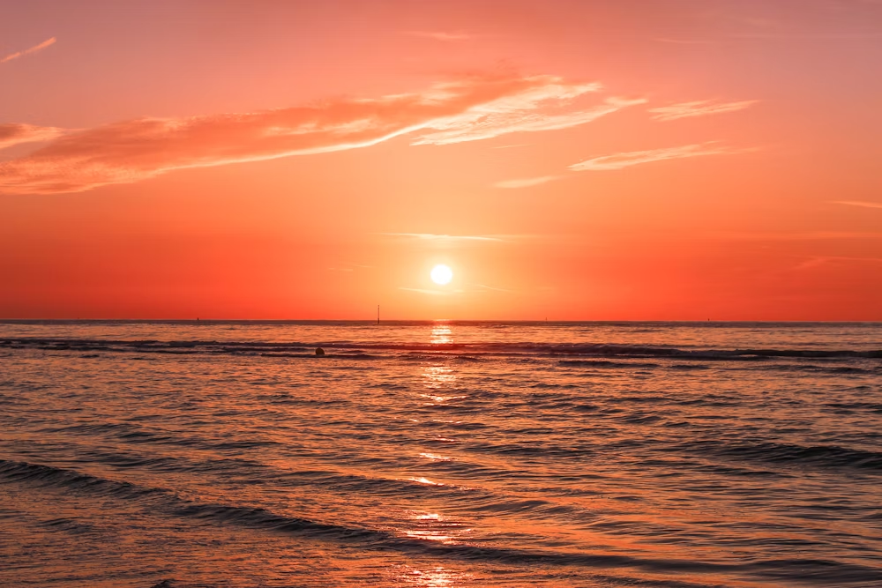
APP INTEGRATION
Displaying detected signs or translations within the app's user interface.
Each training signs will be saved in a folder

Slide 8

cap=cv2.VideoCapture(0)
#set mediapipe model
with mp_holistic.Holistic(min_detection_confidence=0.5,min_tracking_confidence=0.5)as holistic:
#NEW LOOOP
#loop through actions
for action in actions:
#loop sequence(videos)
for sequence in range(no_sequences):
#loop through videp length(sequence length)
for frame_num in range(sequence_length):
#read feed
ret,frame=cap.read()
#make detections
image,results= mediapipe_detection(frame, holistic)
print(results)
#draw landmarks
draw_styled_landmarks(image,results)

Slide 9
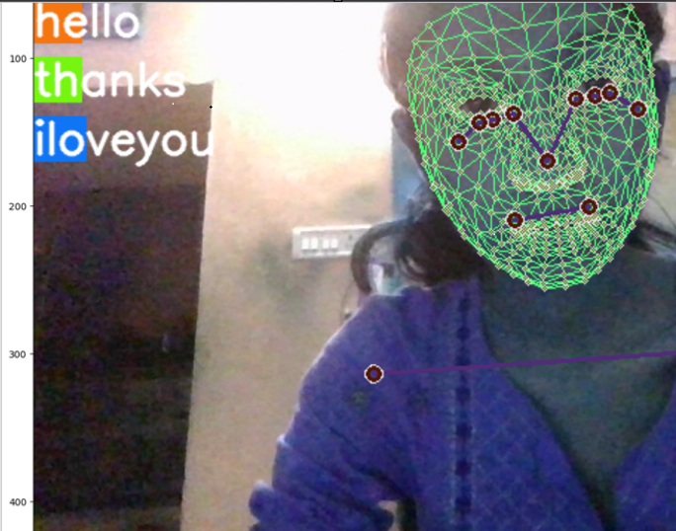
from tensorflow.keras.models import Sequential
from tensorflow.keras.layers import LSTM,Dense
from tensorflow.keras.callbacks import TensorBoard
model=Sequential()
model.add(LSTM(64,return_sequences=True, activation='relu',input_shape=(30,1662)))
model.add(LSTM(128,return_sequences=True, activation='relu'))
model.add(LSTM(64,return_sequences=False, activation='relu'))
model.add(Dense(64,activation='relu'))
model.add(Dense(32,activation='relu'))
model.add(Dense(actions.shape[0],activation='softmax'))

Slide 10



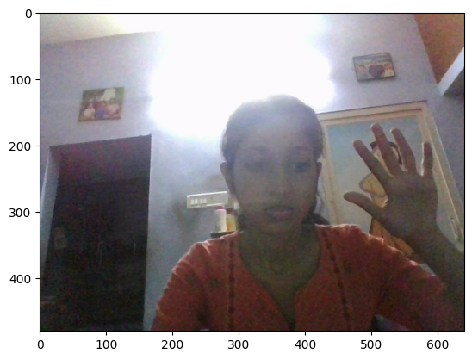

Slide 11

USER INTERACTION
Users can interact with the app by performing sign language gestures in front of the camera.
Detected gestures are translated into corresponding text or visual representations.
Users receive immediate feedback or responses based on the detected signs.

Slide 12
Thank You…

